Slide 1

ITEC 493: IT Security for Managers
Network Security Appliances and Technologies
Ali Mazloum
Integrated Information Technology Department
College of Engineering and Computing
University of South Carolina
Fall 2025

Slide 2
Security Appliances
Security can be achieved through appliances that directly address security and by using the security features in standard networking devices
Using both standard networking devices and security appliances can result in a layered security approach
Appliances include:
Firewalls
Proxy servers
Deception instruments
Intrusion detection and prevention systems
Network hardware security models

Slide 3
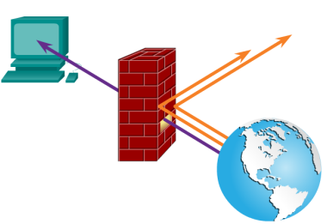
Firewalls
Different types of firewalls and specialized firewall appliances
Firewall Functions
A firewall uses bidirectional inspection to examine outgoing and incoming packets
The actions are based on specific criteria or rules (called rule-based firewalls)
A more flexible type of firewall is a policy-based firewall which allows more generic statements instead of specific rules
Firewalls can also apply content/URL filtering
Firewall

Slide 4
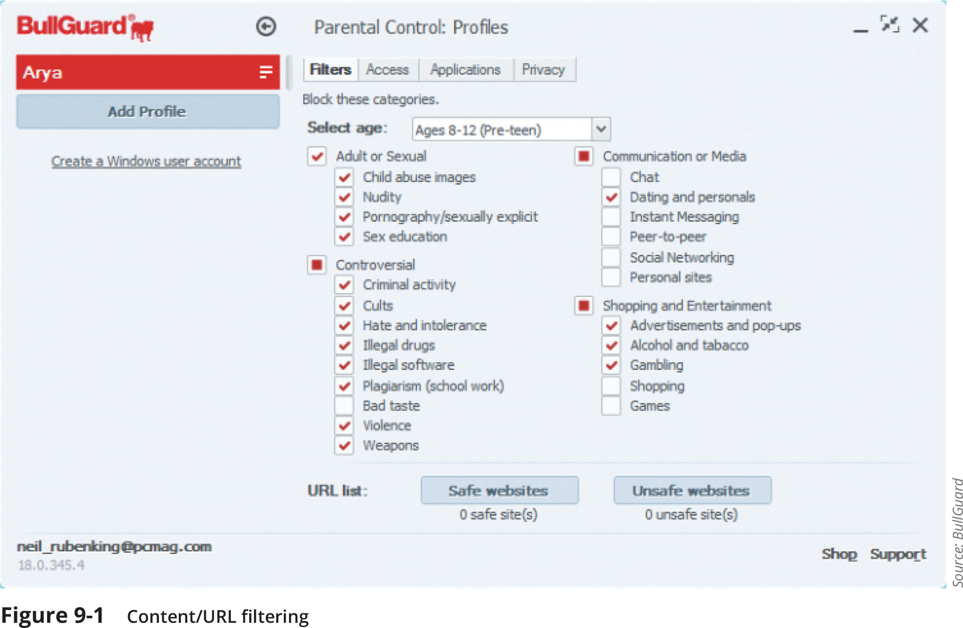
Firewalls
Figure 9-1 Content/URL filtering

Slide 5
Firewalls
Firewall Categories
Stateful vs. stateless
Open source vs. proprietary
Hardware vs. software
Host vs. appliance vs. virtual

Slide 6
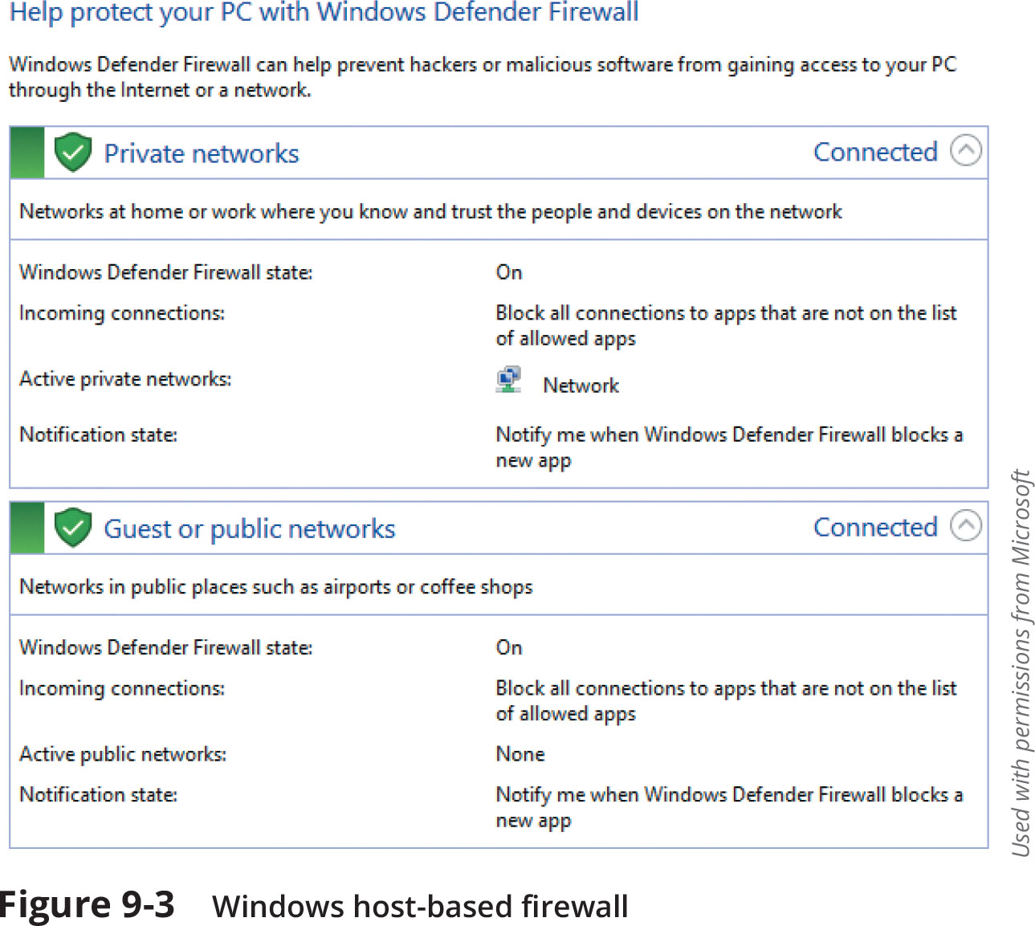
Firewalls
Figure 9-3 Windows host-based firewall

Slide 7
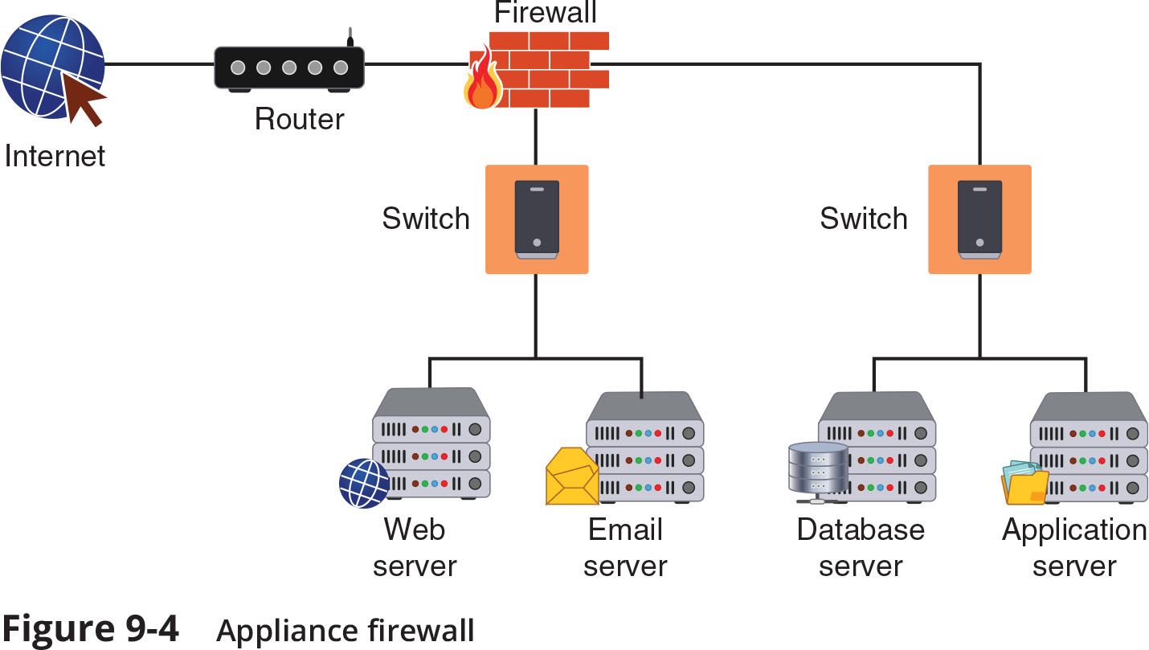
Firewalls
Figure 9-4 Appliance firewall

Slide 8
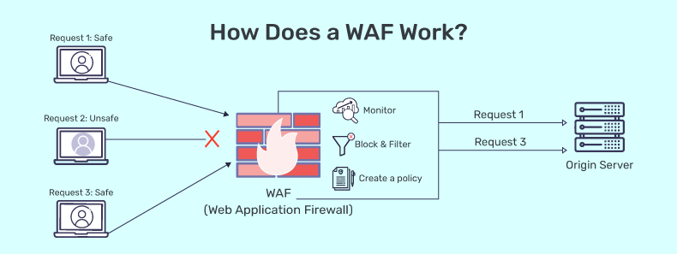
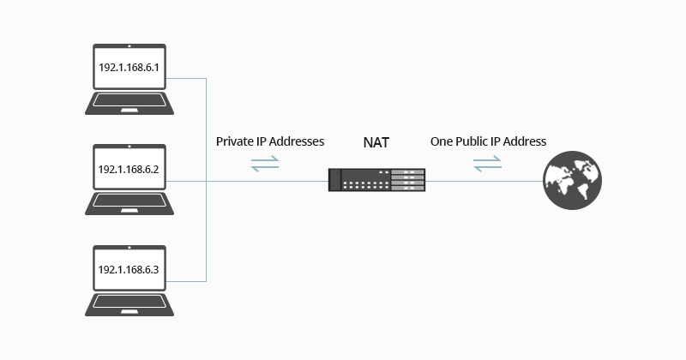
Firewalls
Specialized Firewall Appliances
Web application firewall
Network address translation gateway
Network address translation (NAT) is a technique that allows private IP addresses to be used on the public internet

Slide 9
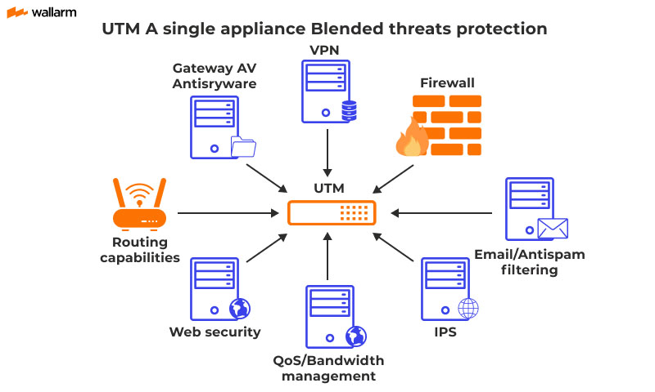
Firewalls
Specialized Firewall Appliances
Next generation firewall (NGFW)
Unified threat management (UTM)
UTM is a device that combines several security functions such as packet filtering, antispam, antiphishing, antispyware, encryption, intrusion protection, and web filtering

Slide 10
Proxy Servers
Proxies are devices that act as substitutes on behalf of the primary device
A forward proxy is a computer or an application that intercepts user requests from the internal secure network and processes the requests on behalf of the user
A reverse proxy routes requests coming from an external network to the correct internal server
A proxy server can provide a degree of protection
It can look for malware by intercepting it before it reaches the internal endpoint
It can hide the IP address of endpoints inside the secure network so that only the proxy server’s IP address is used on the open Internet

Slide 11
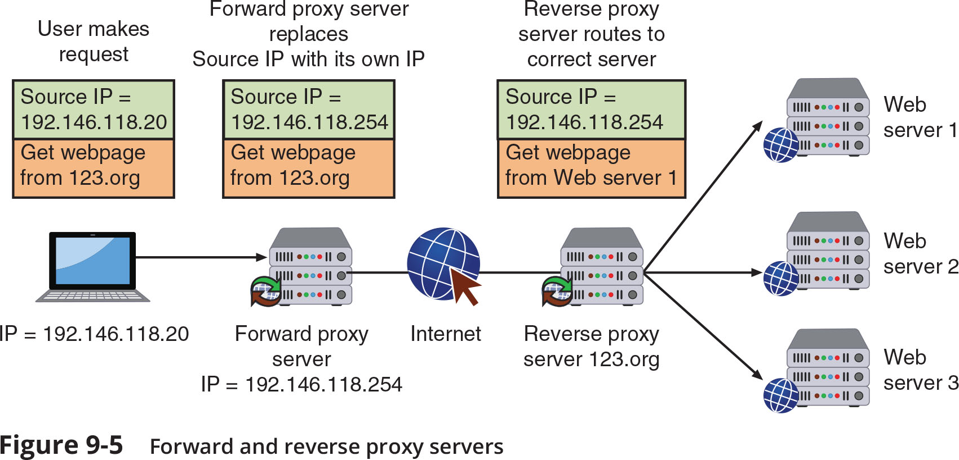
Proxy Servers

Slide 12
Deception Instruments
Deception can be used as a security defense
By directing threat actors away from a valuable asset to something that has little or no value
Network deception can involve creating and using honeypots and sinkholes
Honeypots
A honeypot is a computer located in an area with limited security that serves as “bait” to threat actors
Two goals of using a honeypot:
Deflect
Discover

Slide 13
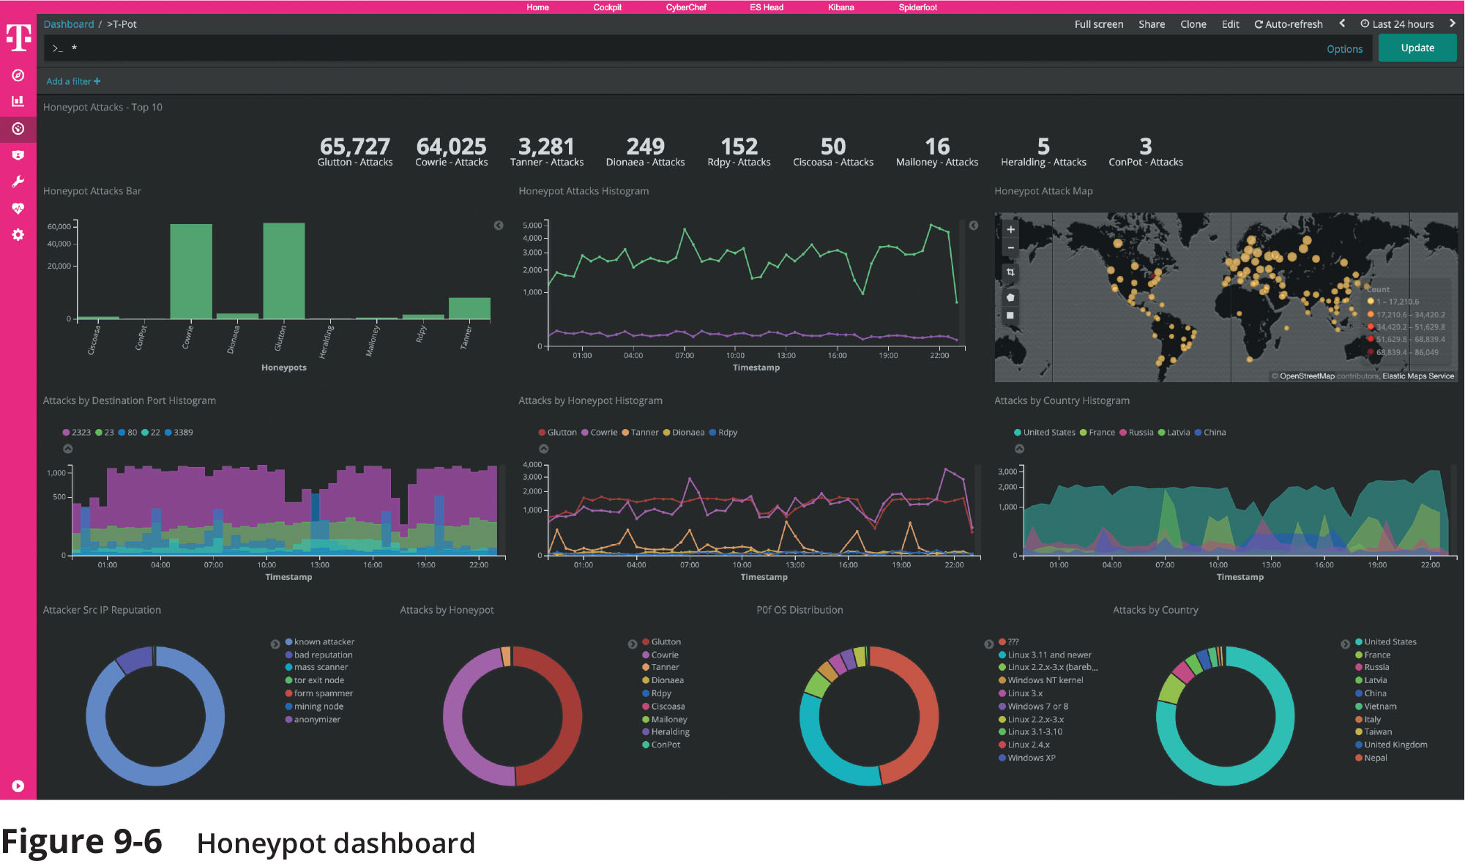
Deception Instruments
Figure 9-6 Honeypot dashboard

Slide 14
Deception Instruments
Sinkholes
A sinkhole is a “bottomless pit” designed to steer unwanted traffic away from its intended destination to another device
The goal is to deceive the threat actor into thinking the attack was successful
Notes:
Put simply, a sinkhole is a server or network segment to which malicious traffic is intentionally directed. It is similar to a honeypot but it is used actively as a defense. Once the traffic is isolated in a sinkhole, it can no longer hurt its intended targets; additionally, the traffic can be analyzed to reveal the source of the attack as well as information about the techniques being employed.
For example, when a Denial-of-Service (DoS) attack is detected against a web server, all of that malicious traffic could instead be directed to a sinkhole. Sinkholes are designed to withstand this traffic and to prevent any packets from coming back out—no backscatter.
Additionally, they are normally outfitted with analysis tools to perform reconnaissance: packet sniffing and flow analysis and traceroutes to the attackers.

Slide 15
Intrusion Detection and Prevention Systems
An intrusion detection system (IDS) can detect an attack as it occurs
An intrusion prevention system (IPS) attempts to block the attack
Inline system is connected directly to the network and monitors the flow of data as it occurs
A passive system is connected to a port on a switch, which receives a copy of network traffic
IDS systems can be managed in different ways:
In-band management is through the network itself by using network protocols and tools
Out-of-band management is using an independent and dedicated channel to reach the device

Slide 16
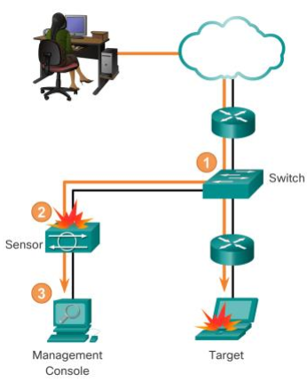
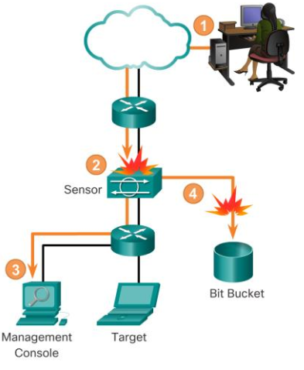
Intrusion Detection and Prevention Systems
IDS
IPS

Slide 17
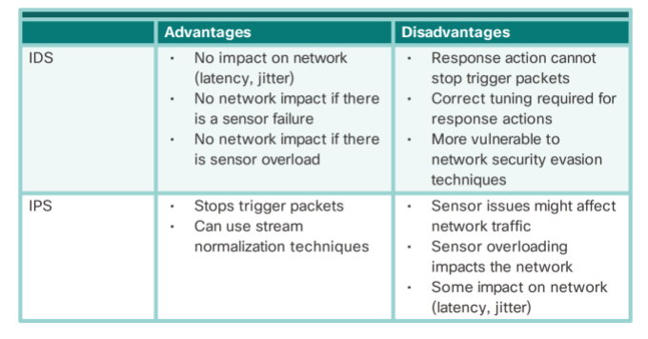
Intrusion Detection and Prevention Systems

Slide 18
Intrusion Detection and Prevention Systems
Monitoring Methodologies
Anomaly-based monitoring compares current detected behavior with baseline
Signature-based monitoring looks for well-known attack signature patterns
Heuristic monitoring uses experience-based techniques

Slide 19
Intrusion Detection and Prevention Systems
A network intrusion detection system (NIDS) watches for attacks on the network
NIDS sensors installed on firewalls and routers gather information and report back to central device
A network intrusion prevention system (NIPS) monitors to detect malicious activities and also attempts to stop them

Slide 20
Security Technologies
There are general security technologies that can provide a defense
Some of these technologies can be found in both standard networking devices (switches and routers) and specialized security appliances
Categories of security technologies include:
Access technologies
Monitoring and managing technologies
Design technologies

Slide 21
Access Technologies
Access Control List (ACL)
An access control list (ACL) contains rules that administer the availability of digital assets by granting or denying access to the assets
Two types of ACLS include:
Filesystem ACLs filter access to files and directories on an endpoint by telling the OS who can access the device and what privileges they are allowed
Networking ACLs filter access to a network
Often found on routers
Router ACLs can be used on external routers to restrict vulnerable protocols and limit traffic from entering the network
Internal router ACLs are often configured with explicit allow and deny statements for specific addresses and protocol services

Slide 22
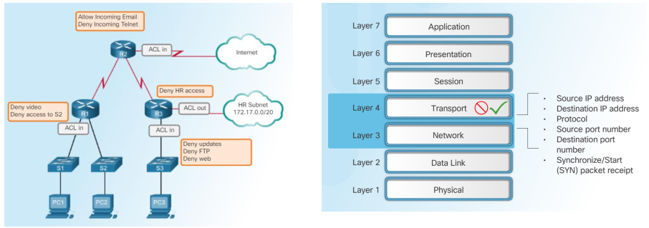
Access Technologies
ACLs are usually part of a router firewall, which permits or denies traffic based on Layer 3 and Layer 4 information
They are stateless; simple policy table; it filters traffic based on specific criteria

Slide 23
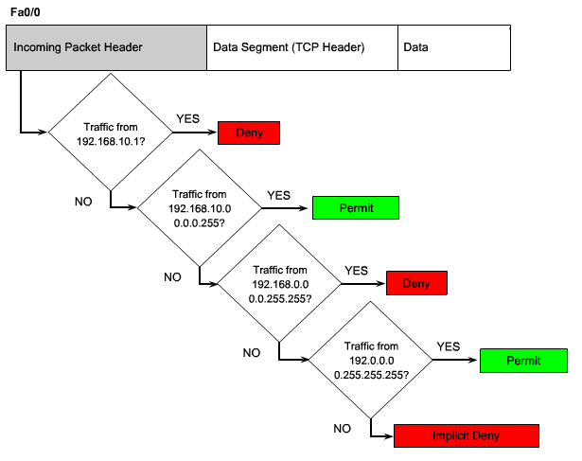
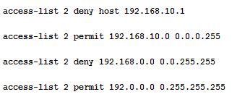
Access Technologies
Sequential list of permit or deny statements that apply to addresses or upper-layer protocols.
Control traffic into and out of your network.
Permitting or denying network hosts or addresses.

Slide 24
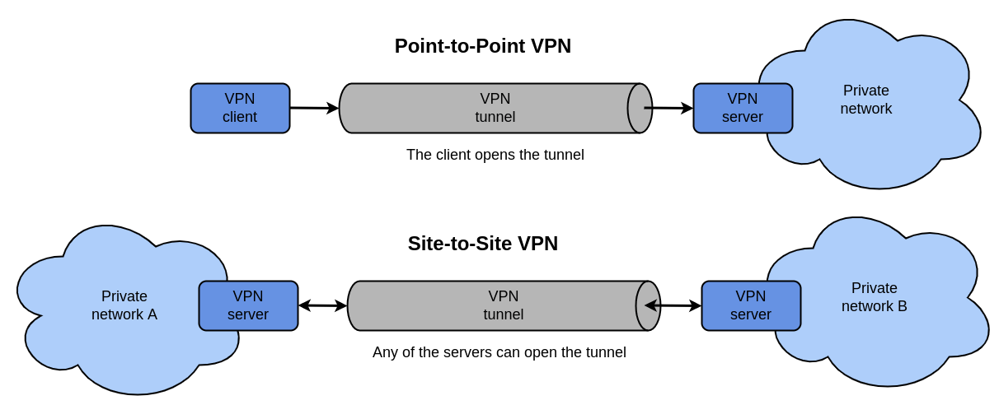
Access Technologies
Virtual Private Network (VPN)
A VPN is a security technology that enables authorized users to use an unsecured public network (the Internet) as if it were a secure private network
Two common types of VPNs:
A point-to-point VPN (remote access VPN)
A site-to-site VPN

Slide 25
Access Technologies
Network Access Control (NAC)
NAC examines the current state of a system or network device before it can connect to the network
Any device that does not meet a specified set of criteria can connect only to a “quarantine” network where the security deficiencies are corrected
NAC uses software “agents” to gather information and report back (called host agent health checks)
An agent may be a permanent NAC agent or a dissolvable NAC agent that disappears after reporting information to the NAC
The NAC technology can be embedded within a Microsoft Windows Active Directory (AD) domain controller
NAC uses AD to scan the device (called agentless NAC)

Slide 26
Access Technologies
Data Loss Prevention
DLP is considered as rights management, or the authority of the owner of the data to impose restrictions on its use
DLP is a system of security tools that is used to recognize and identify data that is critical to the organization
Most DLP systems use content inspection which is defined as a security analysis of the transaction within its approved context
An administrator creates DLP rules based on the data and the policy
These rules are loaded into a DLP server
When a policy violation is detected by the DLP agent it is reported back to the DLP server

Slide 27
Access Technologies
Data Loss Prevention (continued)
When a server is notified of a policy violation different actions can be taken:
Block the data
Redirect it to an individual who can examine the request
Quarantine the data until later
Alert a supervisor of the request

Slide 28
Technologies for Monitoring and Managing
Packet Capture and Analysis
Analyzing packets helps to monitor network performance and reveal cybersecurity incidents
Monitoring traffic on switches can be done in two ways:
A separate port TAP (test access point) can be installed
Port mirroring (also called port spanning) allows the administrator to configure the switch to copy traffic on some or all ports to a designated monitoring port on the switch
Monitoring Services
An external third-party monitoring service can be used to provide additional resources to assist an organization in its cybersecurity defenses

Slide 29
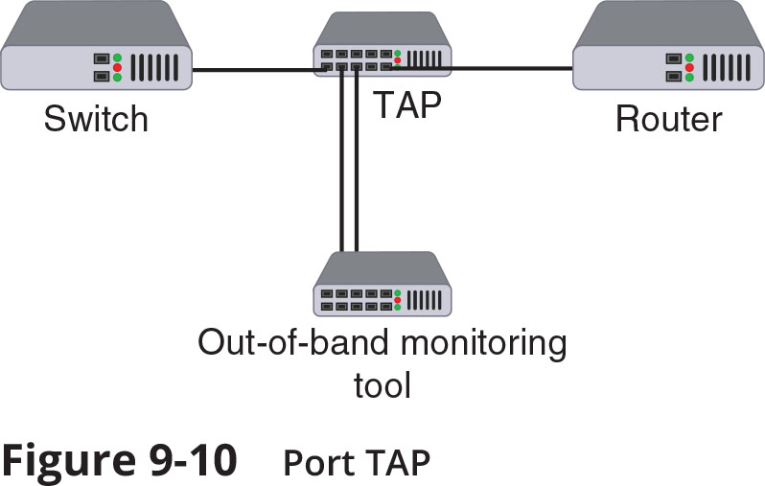
Technologies for Monitoring and Managing
Figure 9-10 Port TAP

Slide 30
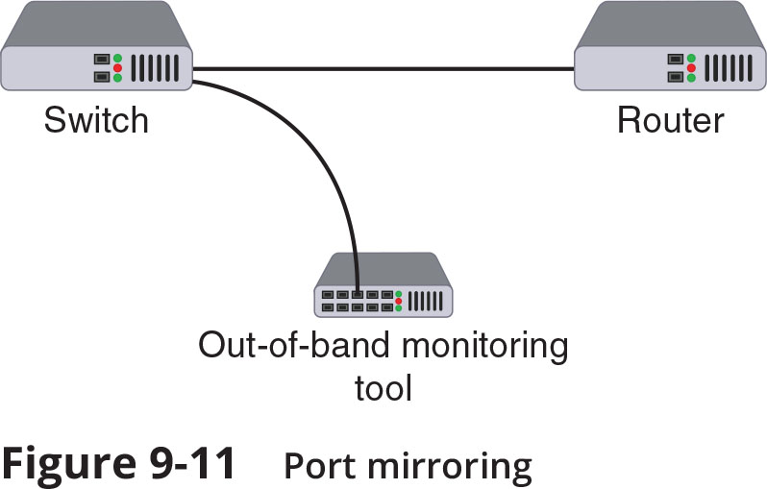
Technologies for Monitoring and Managing
Figure 9-11 Port Mirroring

Slide 31
Technologies for Monitoring and Managing
File Integrity Monitors
File integrity monitors examine files to see if they have changed
File integrity monitors are used for detecting malware as well as maintaining compliance with industry-specific regulations
Quality of Service (QoS)
QoS is a set of network technologies used to guarantee its ability to dependably serve network resources and high-priority applications to endpoints
A network administrator can assign the order in which packets are handled and the amount of bandwidth given to an application or traffic flow (called traffic shaping)
Almost all firewalls today recognize QoS settings

Slide 32
Design Technologies
Network Segmentation
Examples of network segmentation include virtual LANs and a demilitarized zone
Zero trust is a strategic initiative about networks that is designed to prevent successful attacks
It attempts to eliminate the concept of trust from an organization’s network architecture
Zero trust requires that networks be segmented
A network can be segmented by separating devices into logical groups by creating a virtual LAN (VLAN)
VLANs can be isolated so that sensitive data is transported only to members of the VLAN

Slide 33
Design Technologies
Network Segmentation (continued)
A demilitarized zone (DMZ) is a separate network located outside secure network perimeter
Untrusted outside users can access DMZ but cannot enter the secure network
A common approach to configuring a DMZ is to use a jump box (sometimes called a jump server or jump host)
A jump box is a minimally configured administrator server that connects two dissimilar security zones while providing tightly restricted access between them

Slide 34
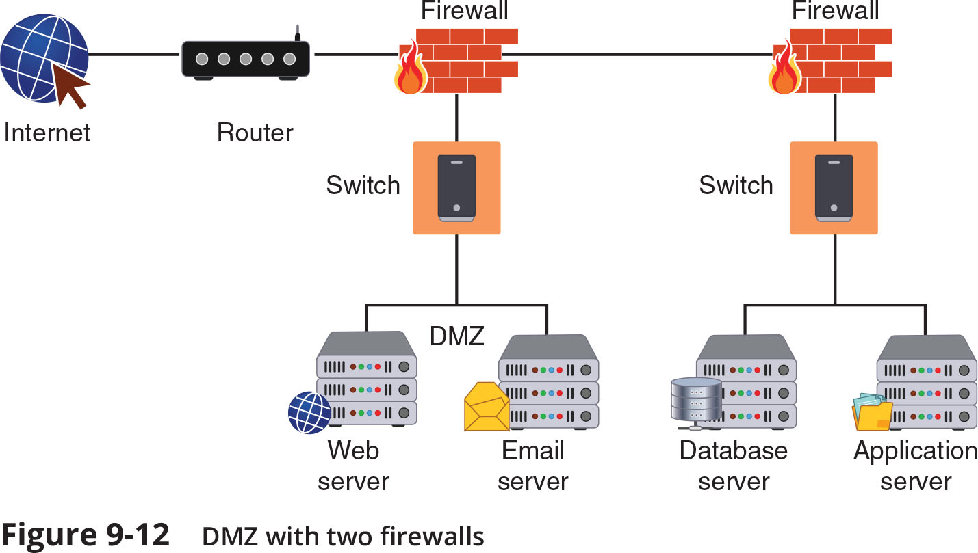
Design Technologies
Figure 9-12 DMZ with two firewalls

Slide 35
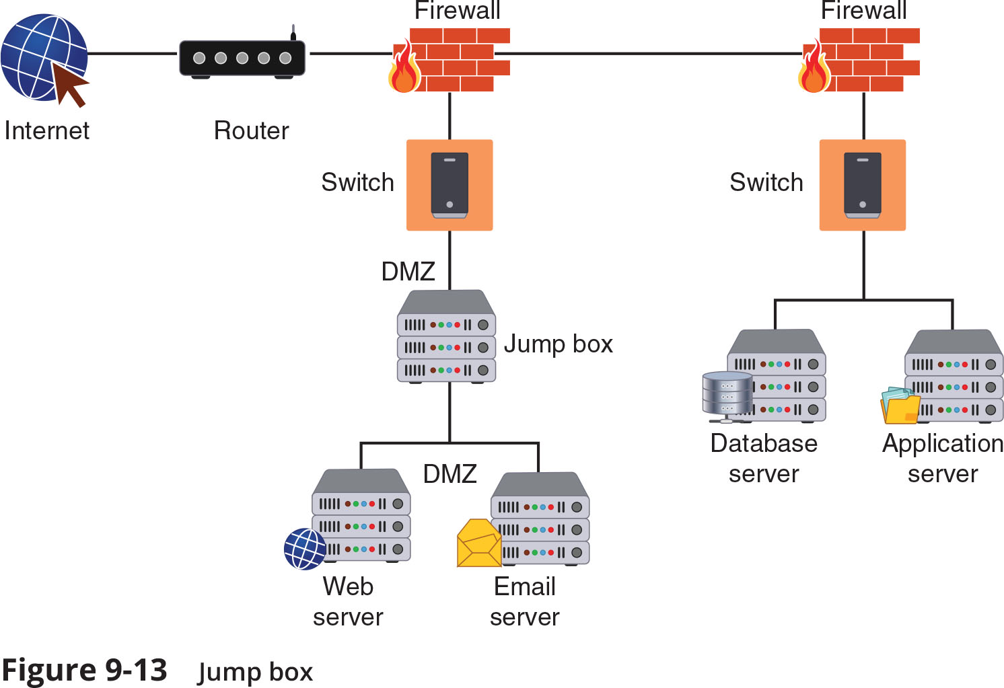
Design Technologies
Figure 9-13 Jump box

Slide 36
Design Technologies
Load Balancing
Load balancing is a technology that can help to evenly distribute work across a network and can allocate requests among multiple devices
Advantages of load-balancing technology:
Reduces probability of overloading a single server
Optimizes bandwidth of network computers
Load balancing is achieved through software or hardware device (load balancer)
Different scheduling protocols used in load balancers:
Round-robin
Affinity

Slide 37
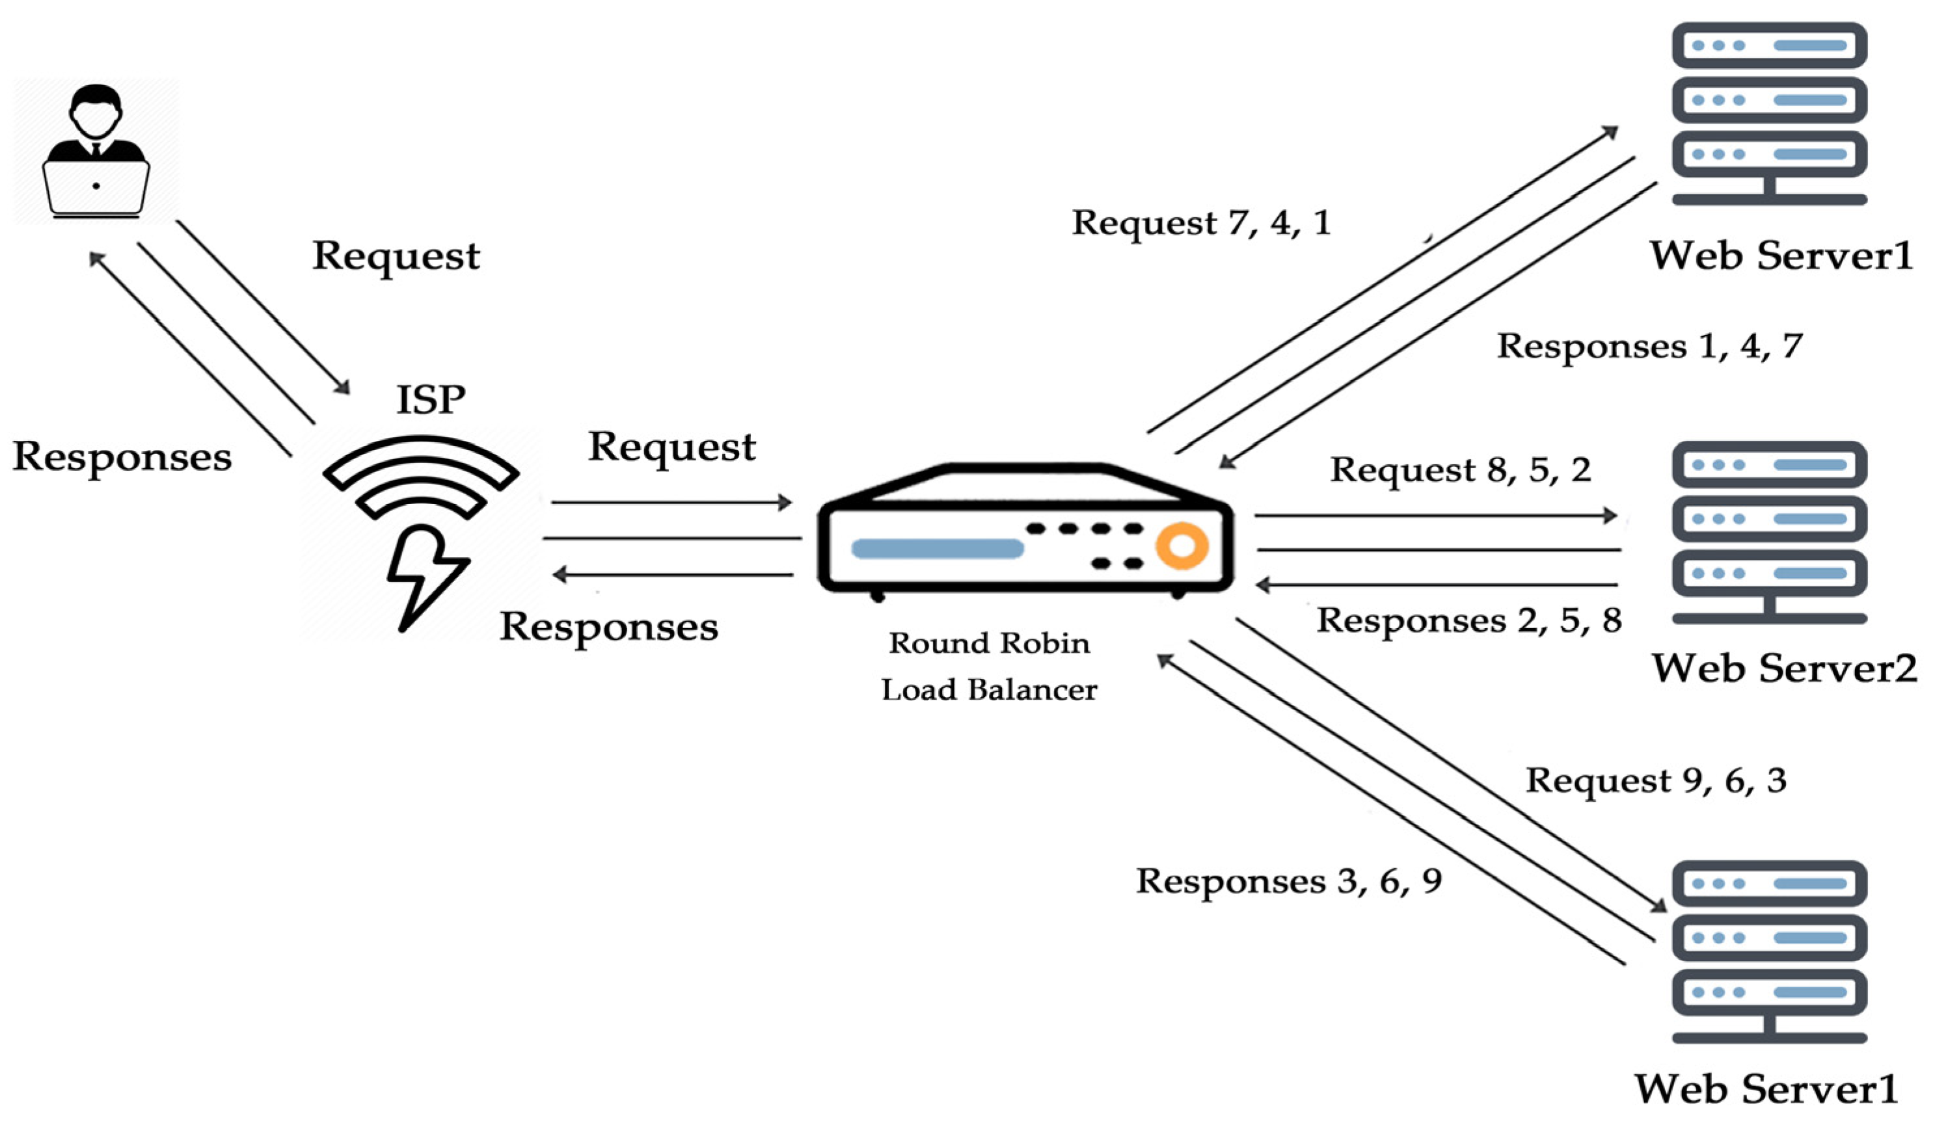
Design Technologies

Slide 38
Design Technologies
Load Balancing (continued)
Security advantages of using a load balancer:
They can detect and stop attacks directed at a server or application
Can also detect and prevent protocol attacks
Some load balancers can hide HTTP error pages or remove server identification headers from HTTP responses, denying attackers additional information about the internal network

